Slide 1
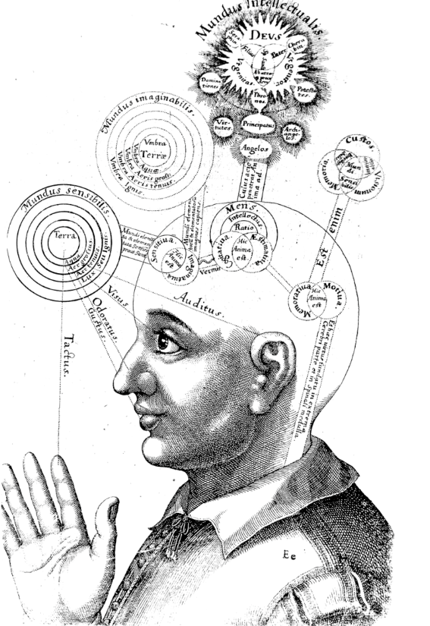
Overview
What is Consciousness
Consciousness, brain, and cognition
3. Consciousness, AI, and intelligence
17th century representation of consciousness by Robert Fludd, Consciousness - Wikipedia

Slide 2
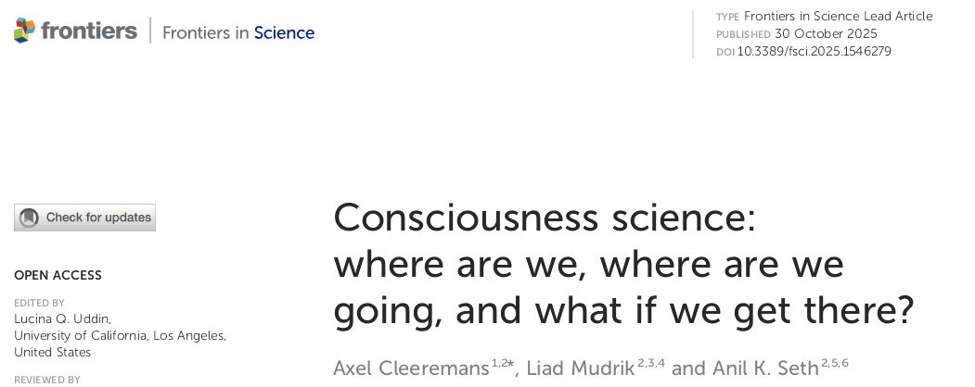

«But today, there is also a sense that the ﬁeld has reached an uneasy stasis… a recent review …identifed over 200 distinct approaches to explaining consciousness, exhibiting a breathtaking diversity in metaphysical assumptions and explanatory strategies»
«Consciousness research may beneﬁt from a stronger focus on the phenomenological character of conscious experiences»
«… research is gradually transitioning from empirical identiﬁcation of neural correlates of consciousness to encompass a variety of theories»
Notes:
Francis Crick (1962) – neural basis of consciousness (with Christof Koch), NCC
John Eccles (1963 – mind–brain interaction (with Karl Popper)
Gerald Edelman (1972) – neural correlates of consciousness
Roger Sperry (1981) – exploration of the hemispheres and consciousness
Eric Kandel (2000) – neuroscience of memory and conscious experience
Roger Penrose (2020) – con-computable elements of consciousness
Penrose and Stuart Hameroff propose that consciousness arises from quantum state collapses within microtubules
If we get there, implications for AI, Law, Clinical, Science

Slide 3
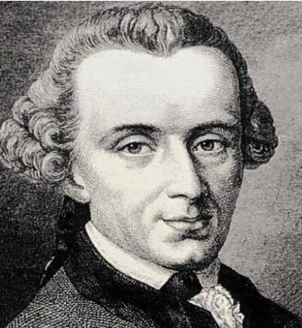

1. What is Consciousness – Attempt #201
Title: Consciousness as “das-Ding-an-Sich”
or
The Super-hard Problem of cinsciousness
The essence of Kant's das Ding-an-sich (thing-in-itself) is that it is the ultimate reality of objects as they exist independently of human perception, a reality that is inherently unknowable to our senses and reason, cf. the Copenhagen explanation of quantum mechanics.
Immanuel Kant
1724-1804
As there is an “objective core” to reality in Kantian terms, I proposes that there is a corresponding “subjective core” to consciousness in Cartesian terms, a phenomenological agency that may be inherently unknowable, as we define and understand rational knowledge, this I will call “The Super-hard Problem of Consciousness”
David Chalmers
1966 -
Weird consequence? If consciousness has a core of subjectivity only known to myself, is it then, stricte dictum, possible to know if others have consciousness? I can only infer (guess) that others are conscious?
Weirder Implication? Since we ourselves are the target for consciousness research, this will make it difficult, perhaps impossible (?), to achieve a full understanding of consciousness (das-Ding-an-Sich), since a system cannot explain itself; Explanans > Explanandum

Slide 4

Distinction between perceptual and phenomenological consciousness, perceptual consciousness is being conscious of something, phenomenological consciousness is the agency of being “me”, “myself”
Duality
Phenomenological consciousness is always present, from birth to death, it is either ON or OFF, e.g. no such thing as decline in consciousness with aging as there is a decline in cognitive capacities
Presence
Phenomenological consciousness is a unique qualitative state while other mental states, e.g. attention, planning, motivation, mood, are quantitative dimensions which fluctuate, they are cyclic
Uniqueness
Notes:
Perceptual consciousness can be both externally and internally driven, is both bottom-up and top-down
Sleep shuts down perceptual consciousness, but not phenomenological consciousness
There is no such thing as “a little conscious”, as there is no such thing as “I think a little” in Cartesian terms
Thoughts are also always present, overlap with consciousness?
Could argue that sleep is an example that consciousness fluctuates, not true, dreams e.g. are always in first person, it is “me” dreaming, agency
In psychology, agency is the feeling of controlling one's own actions and having the capacity to make choices. It is the subjective experience of being the author of one's actions and their consequences, involving intentionality, forethought, self-reactiveness, and self-reflection.
Qualia is the subjective, qualitative, or "what-it's-like" aspects of conscious mental experiences, such as the specific redness of a tomato or the pain from a headache. These are the individual, introspectively accessible properties of a sensation, feeling, or perception that make each experience distinct from others

Slide 5



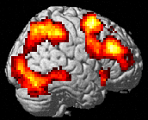
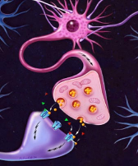

2. Consciousness and the brain
Levels of Explanation
Cultural/Social
Norms, beliefs, attitudes
Clinical
Symptoms, syndromes, diagnosis
Cognitive
Attention, memory, language
Brain
Neuronal systems, networks
Cellular
Synapses, neurotransmitters
Molecular
Genes, DNA, proteins
From Hugdahl & Sommer, Schizophrenia Bulletin, 2018

Slide 6
Why are there no genetic markers of consciousness?
I asked ChapGPT-5 «Discuss the proposition, «If consciousness is a biological…….»
«If consciousness is a biological phenomenon, there should be genetic markers of that phenomenon…
…but humans are conscious to the same degree, there is no variation, while genetics (evolution) is built on individual variation
Does this lead to another weird consequence: Is consciousness not a biological phenomenon (?)
There is no known single “consciousness gene.” Instead, there are many genetic variants that can influence traits related to awareness, arousal, attention, and the brain’s capacity to integrate information.
Variation in consciousness-related processes does exist. People differ in baseline arousal, attention span, perceptual thresholds, and how readily content becomes conscious.
These differences reflect genetic variation in brain development, neurotransmitter systems, and network dynamics—not a simple absence or presence of consciousness.
- There are genetic influences on brain structure and function that indirectly affect conscious processing: neuronal development, synaptic signaling, neurotransmitter systems (dopamine, GABA, glutamate), energy metabolism, sleep regulation, and cortical network connectivity.
Notes:
There isn’t a single gene for consciousness. Consciousness isn’t caused by one gene or a small gene set. It’s a highly complex property that emerges from the brain’s large-scale network dynamics, and genetics contributes to the brain’s structure and function in many interconnected ways.

Slide 7
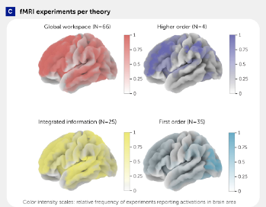
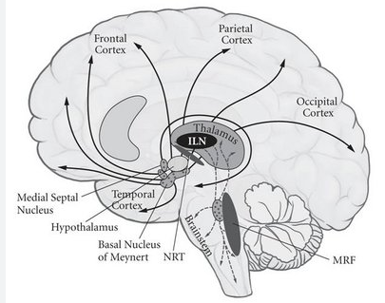
The brain and neural correlates of consciousness
Cleeremans et al., 2025, Figure 1
Guiseppi Moruzzi and Horace Magoun (1949)
Moruzzi and Magoun discovered that stimulating the brainstem's reticular formation in cats caused widespread cortical arousal, as seen in EEG desynchronization, called the reticular activating system (RAS)
«Most, if not all, theories include claims and concepts that are somewhat fuzzy, often almost metaphorical, and these are then translated into neural terms in ways that are sometimes too simplistic, for example by debating whether consciousness is subserved by the front or the back of the brain» (Cleeremans et al, 2025, p,7)
Wilder Penfield (1975). Consciousness and free will might not be fully explained by neural mechanisms alone,… a form of dualism, that the mind operates in concert with the brain but is not reducible to it, challenging strict materialist views
Absence of “uniqueness”
Wolf Singer (1989) proposed that synchronized gamma-band oscillations (30–80 Hz) across distributed neural networks are crucial for binding sensory information into unified percepts—a process believed to be essential for conscious awareness
For a neural event to fully represent a mental event, there must be some kind of unique neural characteristics of that event
Notes:
first-order state theories refer to approaches that explain conscious experience in terms of direct representations of the world, without requiring higher-level monitoring or meta-representations.
Higher-Order Theories: A mental state becomes conscious only when there is a higher-order representation (a thought or perception) about that first-order state. Consciousness requires meta-awareness.
Integration: Consciousness requires information that is unified, not reducible to independent parts. Differentiation: The system must have many possible states (rich informational structure). Φ (phi): A measure of how much the system’s causal structure is both integrated and differentiated.

Slide 8
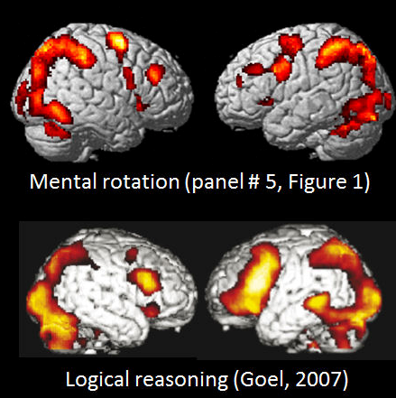
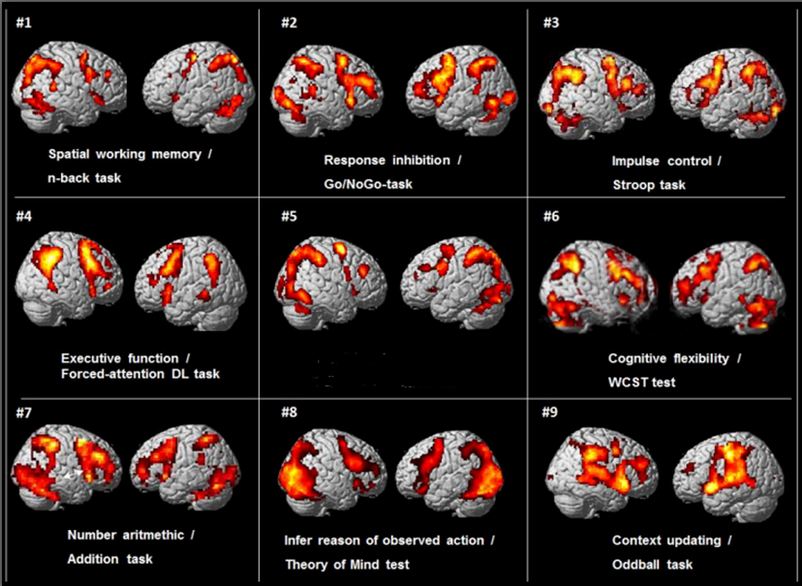
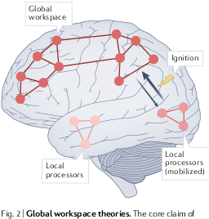
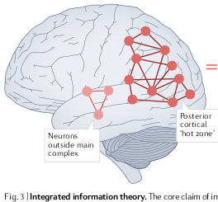


The Sensitivity- Specificity Problem
Seth & Bayne, 2022
V. Goel, Trends in Cogn. Neurosci., 2007
L/R discrimination task
L/R discrimination task
Seth & Bayne, 2022
Lycke, Specht, Ersland et al., Scand. J. Psychol., 2008

Slide 9
Seth & Bayne, 2022
L/R discrimination task
Seth & Bayne, 2022

Slide 10

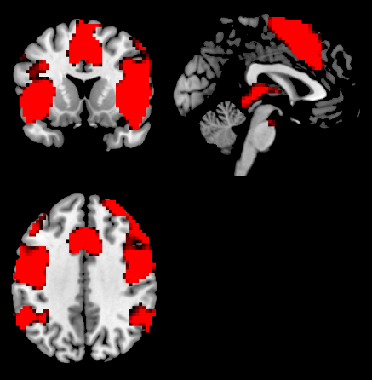
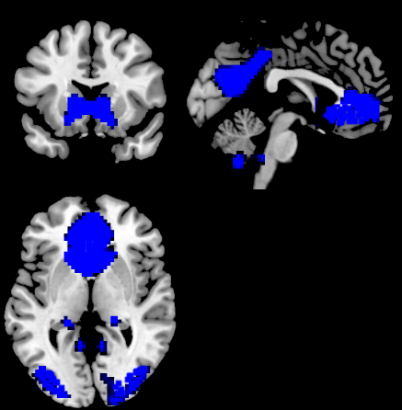
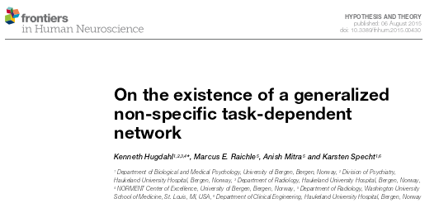
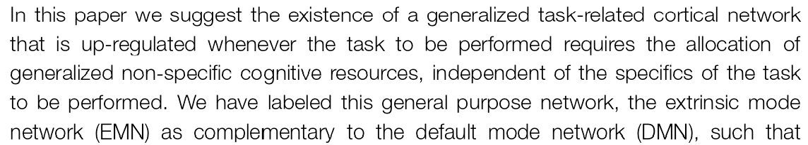
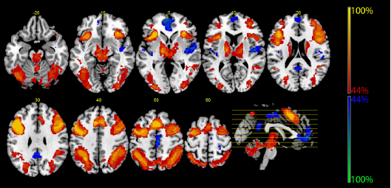
Extrinsic Mode Network (EMN)
Default Mode Network (DMN)
Anterior cingulate (ACC)
PCC/Precuneus
The EMN is an externally directed, task-positive cortical network, up-regulated in situations with allocation of cognitive resources, independent of the nature of the task. It is an effort-mode network (cf. Multiple Demand Network; Execeutive Network)
The DMN is an internally directed task-negative, self-referential cortical network; anti-correlated with task-positive networks, it is a resting-state network in the absence of cognitive tasks (but see recent developments)
Raichle ME, MacLeod AZ, Snyder AZ, Powers WJ, Gusnard DA, Shulman GL. 2001. A default mode of brain function. PNAS, doi:10.1073/pnas.98.2.676

Slide 11
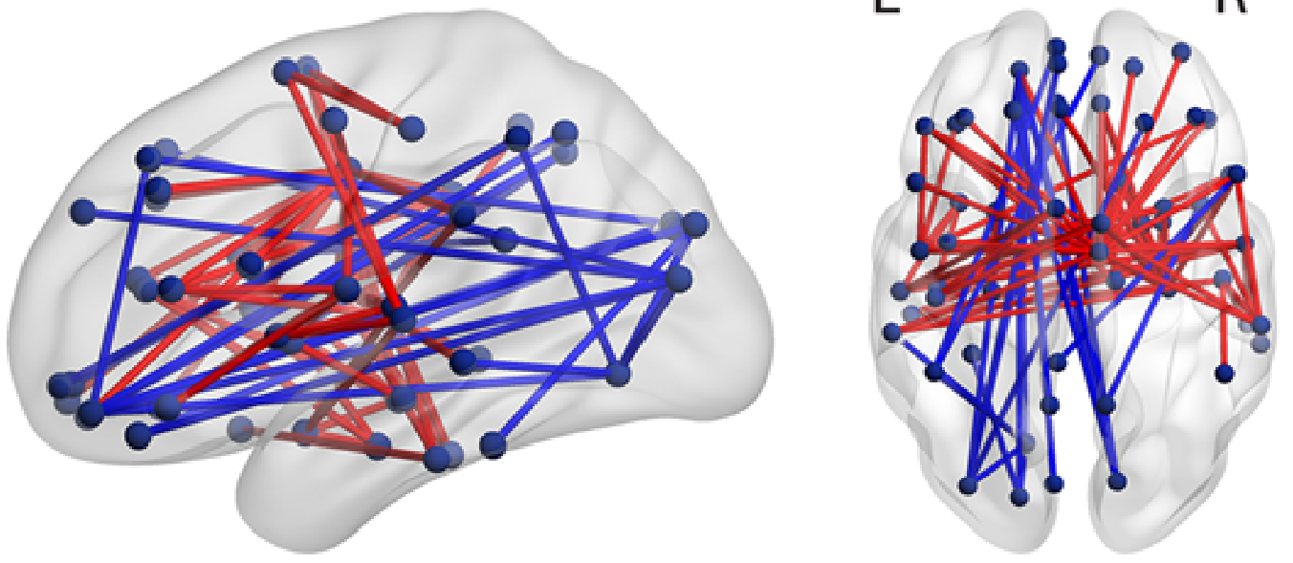
If there are unique neural correlates of consciousness (and that may be the case), I see this as the dynamic interplay across time of a few large-scale networks, dancing with each other like waves on an ocean, where “large-scale” means distributed anatomy across the brain.
Such large-scale networks may follow the principle of self-organization, from which consciousness and cognition may arise (cf. the work by E.K. Miller)

Slide 12
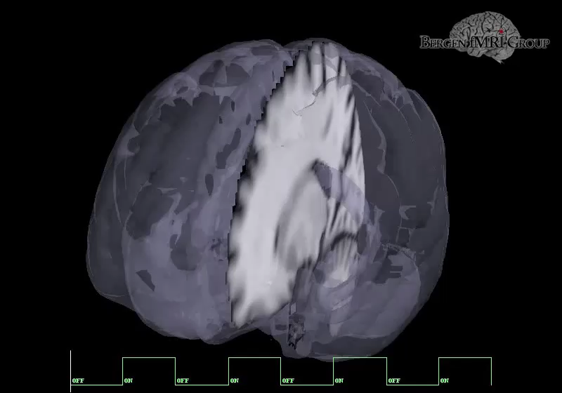
Blue = DMN
Red = EMN
Animation by Alexander Craven and Kenneth Hugdahl, Bergen fMRI Group

Slide 13
Consciousness and cognition
Jeffrey Grey on Consciousness. 2004
Much of our behaviour is accomplished with little or no participation from conscious experience
(KH: Conscious experience = our cognitive world, is synonymous with perceptual consciousness, while our subconscious world is embedded in phenomenological consciousness)
Our conscious experience of our behaviour lags the behaviour itself by around a fifth of a second - we become aware of what we do only after we have done it
Notes:
Agree with Jeffrey Grey, but not sure how relevant it is for consciousness, emotions are not primary targets for consciousness

Slide 14
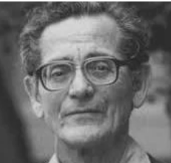
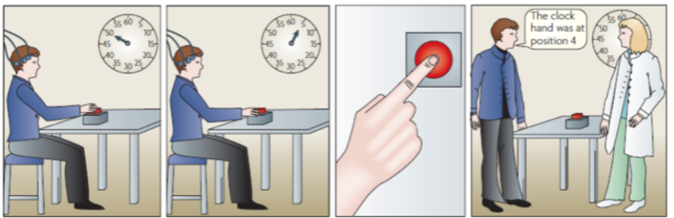
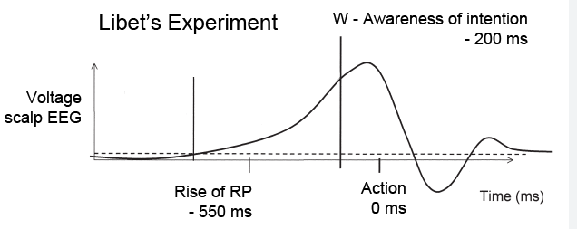
The Libet experiments
Benjamin Libet (1916 – 2007)
Bereitsschaftspotensial (Readiness potential)

Slide 15

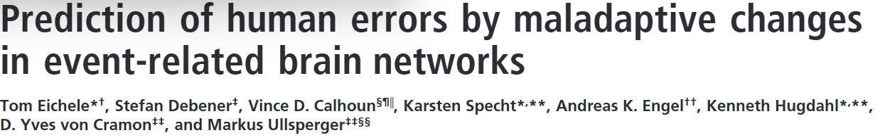


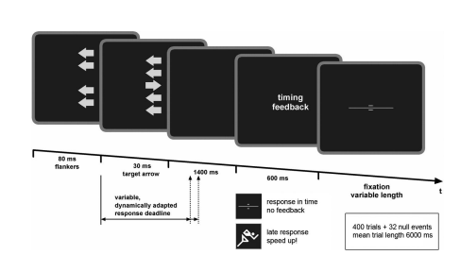
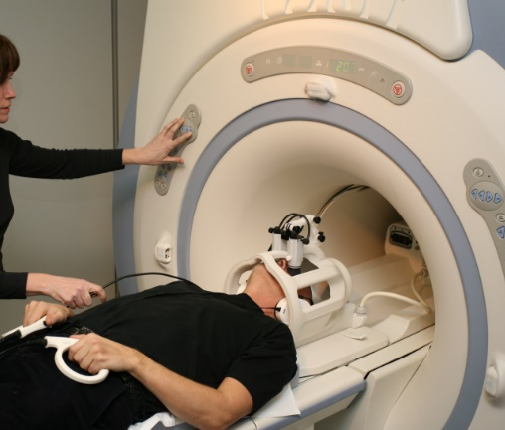
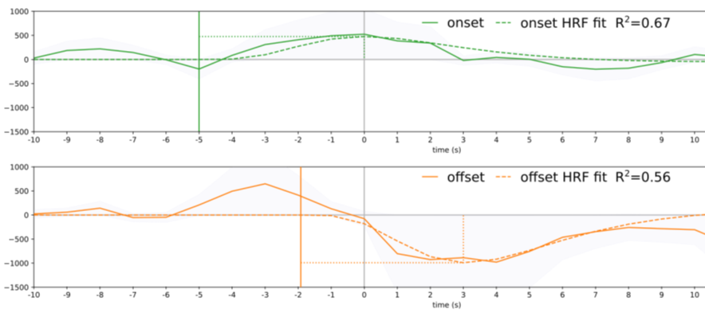
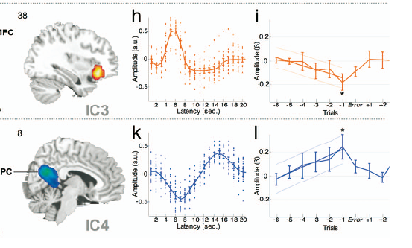
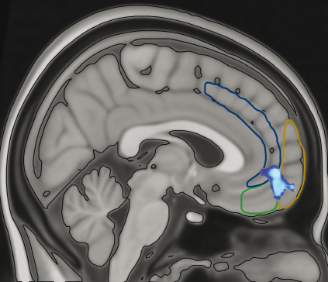


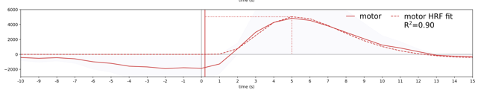
Schizophrenia Bulletin, 2023
2008
r=.81
Time in sec
Button-press
r=.75
Time in sec
Button-press
Button-press
r=.95
Button-press

Slide 16
What is going on in these examples: Is the brain more conscious than “me”?
A critical view may suggest that what is happening in these experiments is momentary random fluctuations in brain activity, which drive arbitrary, purposeless movements, and which may coincide with the presentation of a task to be performed. Cannot rule out that possibility
An alternative view may be that these examples show the brain as a top-down actor which initiates awareness of an event, which in turn tunes predictions about future events, awareness may thus be synonymous with perceptual consciousness, which in turn is distinct from phenomenological consciousness,

Slide 17
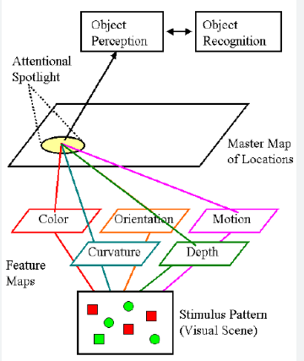
What initiates Awareness, the role of Attention
A recurrent theme in consciousness research is that attention “moves consciousness in and out of focus”
Treisman's "attention spot" relates to her Feature Integration Theory, where a spatial spotlight of attention binds individual features (like color and shape) into a single, coherent object. In this theory, information is first registered in a pre-attentive stage, and then a focused, "spot" of attention at a specific location brings the features together to form a complete perception. This helps explain how we can correctly assemble features of an object, especially when many objects are present, and how "conjunction errors" can occur when features are mistakenly combined.
Attention moves the «spotlight» in and out of awareness or perceptual consciousness, while phenomenological consciousness stays constant
Attention makes us aware of «something», but phenomenological consciousness is not about «something», it is just «me»
Notes:
This aspect is of fundamental importance, as it allows to distinguish between two types of attentional processes: a top-down attention and a bottom-up attention

Slide 18
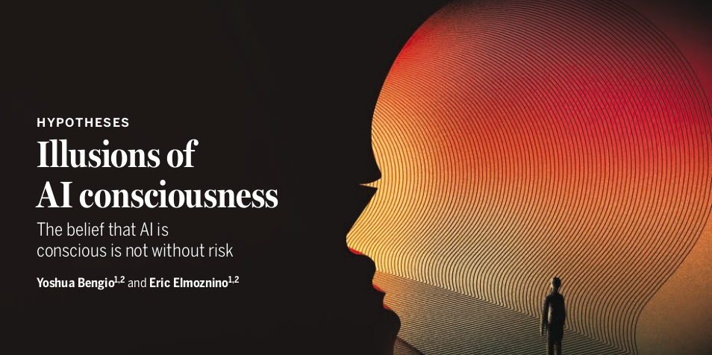
3. Consciousness, Intelligence and AI
Consciousness is an inherently carbon-based biological trait, and therefore AI can never be conscious = substrate dependence
Consciousness is only manipulation of information by an algorithm, irrespective if that is made of neuron or silicon, all it takes is the right code = substrate independence
Bengio and Elmozino, Science, September 2025
«I take intelligence to refer to what a system can do. One useful definition…is the “ability to achieve goals in a wide range of environments”
Seth, A. K. (2025) Conscious artificial intelligence and biological naturalism, Behavioral and Brain Sciences
…but is that how we typically conceive of “intelligence”?
Notes:
Reasoning, goal-directed planning, and linguistic competence are all aspects of intelligence, but non-human animals that lack these competences may still exhibit intelligent behaviour. More general aspects
of intelligence may include the ability to flexibly respond to challenges, and to learn from experience. An ant that flexibly learns to find its way home through a desert is arguably displaying intelligent behaviour
(Simon, 1988).
Consciousness =/ from Intellugence, but in practice the two are closely relateds
Beslutningstrær, random forests, støttevektormaskiner (SVM)
Nevrale nettverk for bildeklassifisering (CNNs)
Reinforcement learning-algoritmer (som lærer gjennom prøving og feiling)
Genetiske algoritmer
Bayesianske nettverk
Og mange, mange flere...

Slide 19

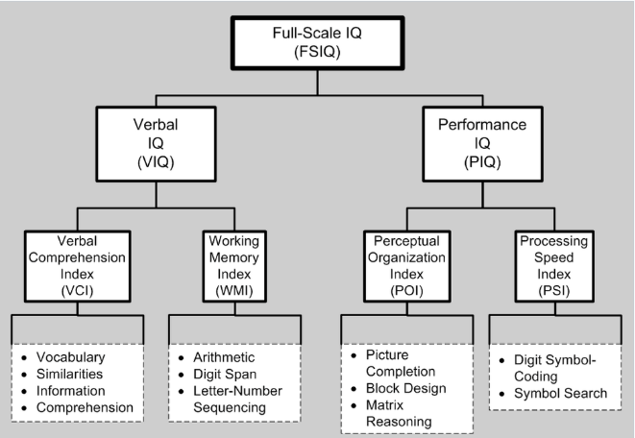
What is “intelligence” ?
If AI is “intelligent”, it should approximate human intelligence, since there is no other known intelligence to compare with, so the question then becomes; WHAT IS HUMAN INTELLIGENCE?
Human Intelligence = The IQ score
Human intelligence is as best conceptualized through an operational definition; it is what is measured by an IQ-test
WHAT IS AN IQ-TEST?
Wechsler Adult Intelligence Test (WAIS)
Human intelligence is thus a quantitative dimensional concept, a variable, while AI seems to be treated as a qualitative non-dimensional concept; like “AI is either intelligent or not”, cf. “…all it takes is the right code”
Figure weighting
Visual puzzles
Cancellation
Notes:
The IQ test is primarily scored for performance but often also for the approach used to reach the solution to a test item
Leads to circular argument; What is an IQ test, it is what measures human intelligence
This scale required a subject to actively do something, such as copying symbols or pointing to a missing detail in a picture, rather than just answering questions. This was an important development, as it attempted to overcome biases that were caused by "language, culture, and education.
AI lacks “history” because it is dependent on data which is in a digital format, and available over the internet. IS AI IQ biased towards the opposite?
One useful definition, drawn from a broad survey, is the “ability to achieve goals in a wide range of environments” (Legg & Hutter, 2007) (p.23). Intelligence in this sense, as in most or all other senses, has to do with the functional capabilities of a system. Reasoning, goal-directed planning, and linguistic competence are all aspects of intelligence, but non-human animals that lack these competences may still exhibit intelligent behaviour. More general aspects of intelligence may include the ability to flexibly respond to challenges, and to learn from experience. An ant that flexibly learns to find its way home through a desert is arguably displaying intelligent behaviour (Simon, 1988). /Seth, 2025/

Slide 20
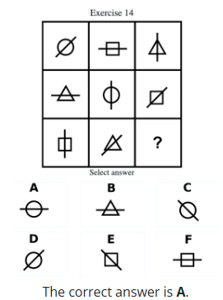
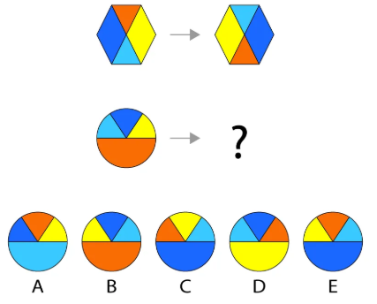
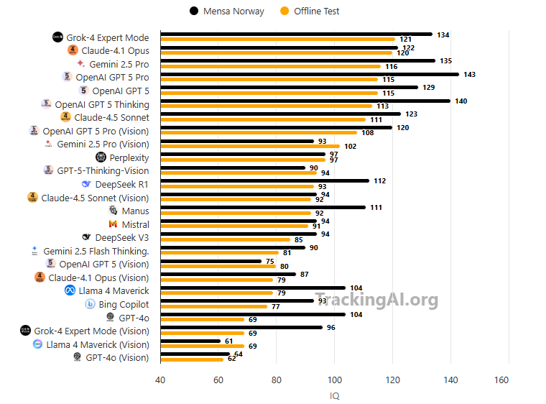
IQ Test for ChatGPT
IQ Test | Tracking AI, by Maxim Lott
Example Mensa test item, N = 35
Example Offline Test item, N = 16
Emotion, Affect and Consciousness
AI learn without any accompanying motivation to do so. It does not “feel anything” when executing the code-lines
(When the Alpha Go program beat the Alpha Go South-Korean champion Lee Sedol, it was Sir Demis Hassabis and the DeepMind team who drank the Champagne, AlphaGo did not feel anything) (Cleeremans et al., 2025)
The DeepMind team celebrated and were euphoric, but the AlphaGo program did not “feel anything”, because “feeling something” is part of being conscious, ergo; AlphaGo and algorithms are not conscious?
?
Humans learn by logic and intuition. AI algorithms learn by training and correlations
AI will need to deliver causal models of the world that goes beyond the correlational models delivered so far in order to be truly intelligent
Will AI without the motivation to “win”, “succeed”, “beat the competitor”, “show off”, “be the first”, “feel the glory”, “uncertainty”, “lose face” etc., ever succeed?

Slide 21
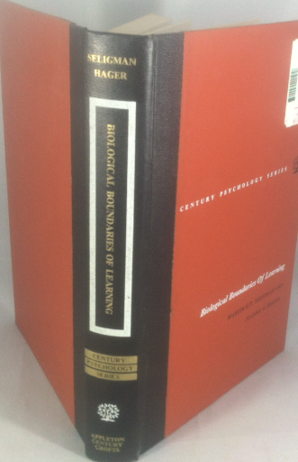
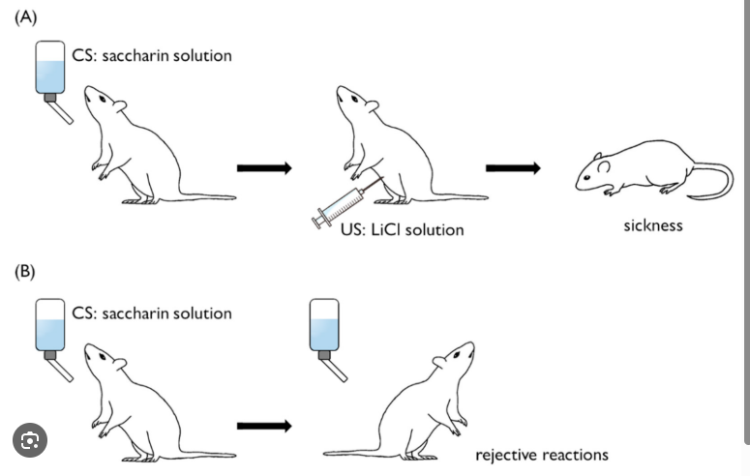
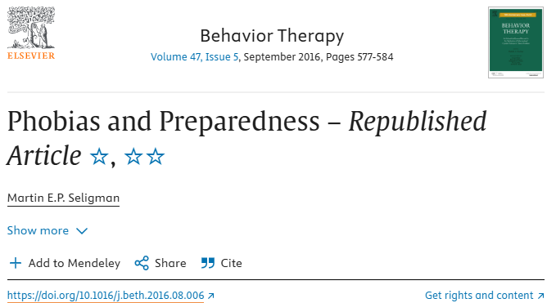
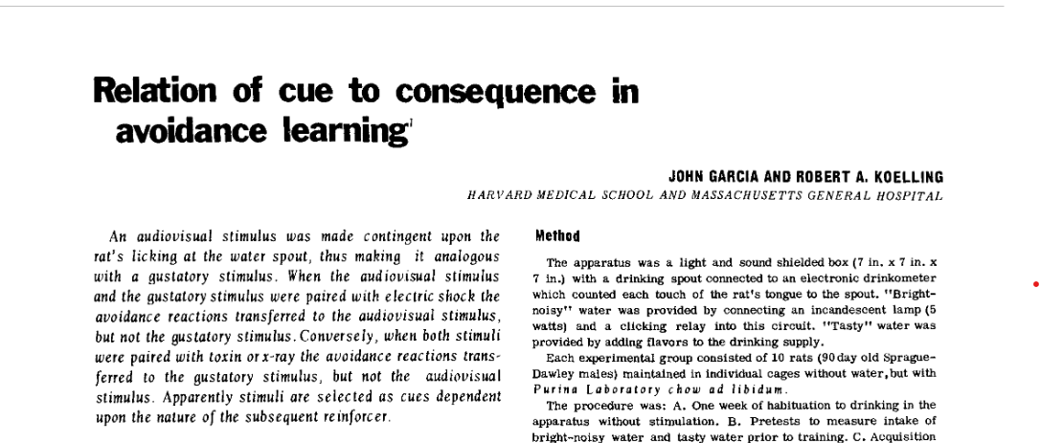



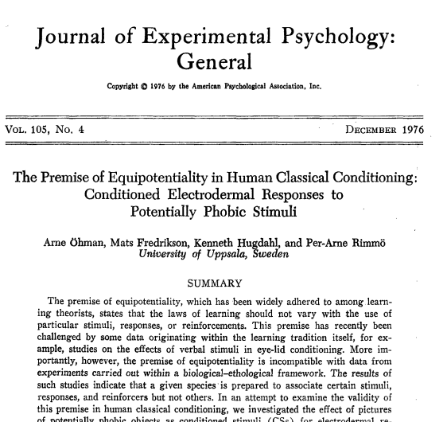
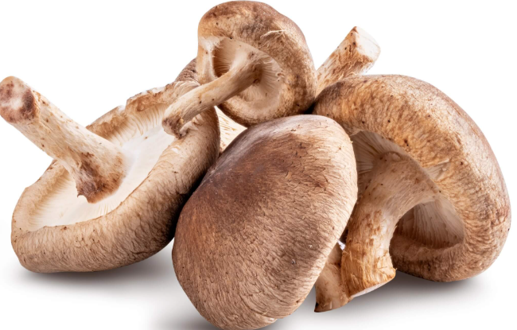
Learning with no training
One-trial Pavlovian conditioning
1971
Martin Seligman: The Preparedness theory, there are biological boundaries of learning, limitations on Pavlovian rules for associative learning
avoidance
Resulted in a view that specific phobias could be consequence of selective conditioning, which in turn contributed to understand mechanisms behind exposure therapy for specific anxiety disorders
Testing the “preparedness theory” in humans, Arne Öhman, Uppsala University, in the 1970s. Recording of ANS activity in conditioning to fearful and neutral visual stimuli
Notes:
Could AI on its own have come up with this sequence of events prior without training

Slide 22
There is a sequence here, which we call science - From an empirical observation in rodents, that lead to a new mechanism for Pavlovian conditioning, which lead to a new hypothesis of evolutionary constraints on learning, and that this could be how specific phobias were acquired, which was tested in humans for verifying the hypothesis, which contributed to novel approach to clinical treatment
Why do I show this example when discussing AI and intelligence?
Because it is in the science domain, at the borders of knowledge, that the real battle between humans and AI will be, not whether Chatbots can take over routine tasks, like summarizing text or finding patterns, but whether it will understand causality beyond correlations

Slide 23

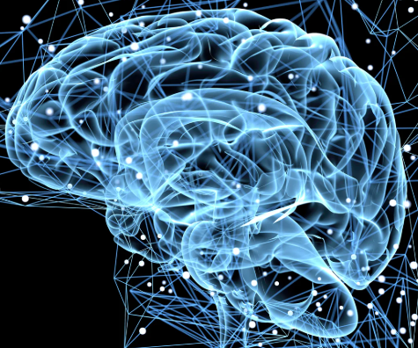
So where are we?
We don’t understand the brain, we don’t understand consciousness, and we are threatened by AI robots to be more conscious and intelligent than us…
So, I guess the only thing we can do is to remember Monty Python and “always look at the bright side of life….”
?
?

Slide 24
The END

